Slide 1

Enterprise Team Foundation Server
Developer Training
Getting Connected, Source Control, & Work Items

Slide 2

Agenda
Licensing
How do I connect to TFS?
Source Control
Work Items
Workspaces
Project Structure
Check-in & Checkout
Branching / Merging
Shelve sets
Team Builds

Slide 3
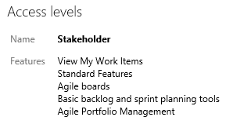
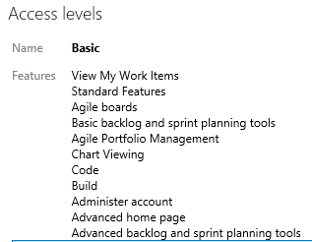
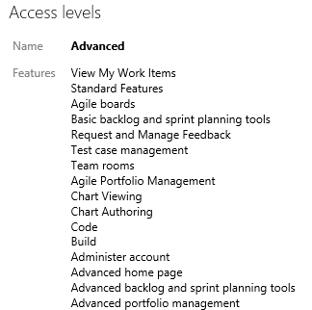
Licensing
Two methods of licensing for ETFS:
Purchase a Team Foundation Server Client Access License (TFS CAL)
“Basic” Team Web Access permission
Purchase an MSDN Subscription (all except MSDN Operating System)
Premium, Test Pro, and Ultimate MSDN’s entitle the user to “Advanced” Team Web Access Permission

Slide 4
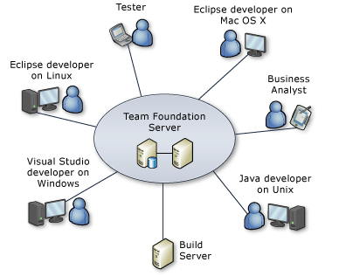
How do I connect to TFS? - Windows
Need ‘Visual Studio Team Explorer’ installed
Need License to connect – CAL (Client Access License) – Team Explorer
If you have any MSDN subscription (except Operating Systems) – you’re licensed

Slide 5
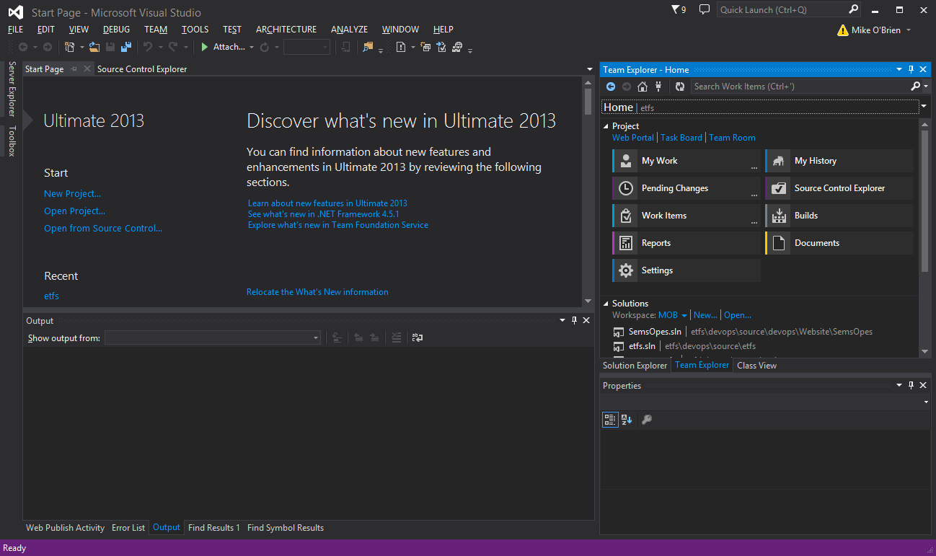
How do I connect to TFS?
Visual Studio Team Explorer
Team Web Access: http://tfs.mmm.com:8080/tfs/

Slide 6
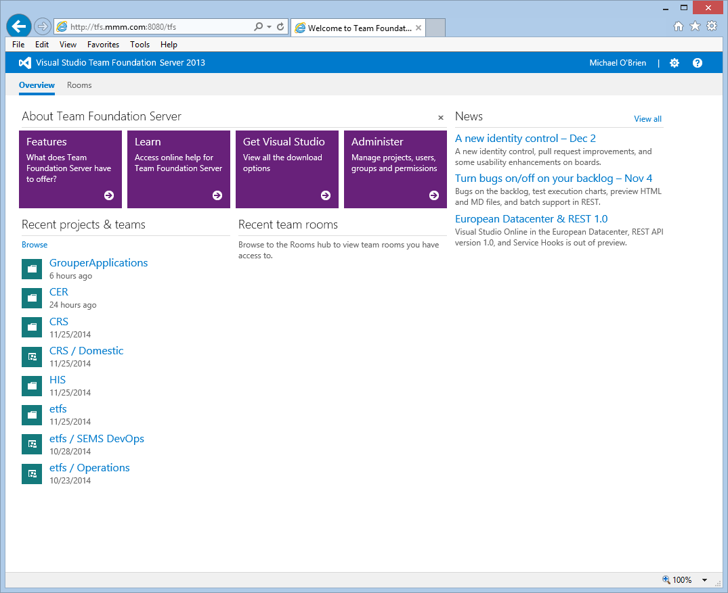
How do I connect to TFS? – Team Web Access
“But I don’t want to install anything …”
Team Web Access: http://tfs.mmm.com:8080/tfs/

Slide 7
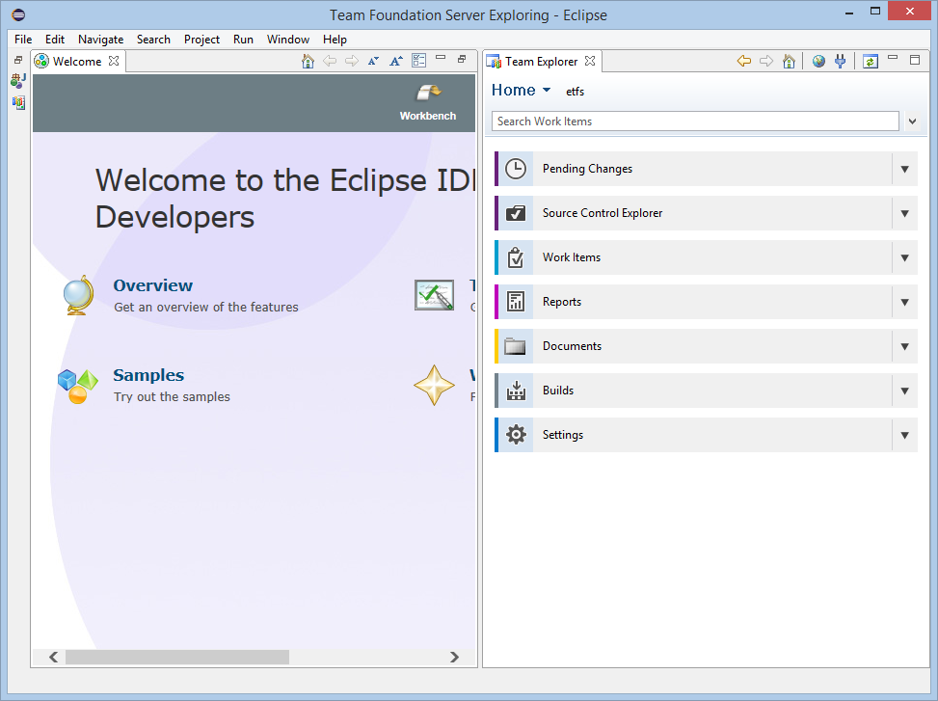
How do I connect to TFS? – Linux/OSX
TFS Everywhere – installs into Eclipse perspective
http://msdn.microsoft.com/en-us/library/gg413285.aspx
Also installs a command line interface
ETFS Team Project with Git source control provider
Git-TF
A set of cross-platform, command line tools that facilitate sharing of changes between Microsoft Team Foundation Server and Git.
http://git-tf.codeplex.com

Slide 8
How do I connect to TFS? – Etc …
But I have “Development Env X” and I NEED environment integration
Team Foundation Server MSSCCI Provider
https://visualstudiogallery.msdn.microsoft.com/06c8e056-7f77-4a5c-9b8b-49318c143df8

Slide 9
Source Control
ETFS offers 2 type of source control:
Team Foundation Version Control (TFVC)
Centralized source control
Git
Decentralized

Slide 10
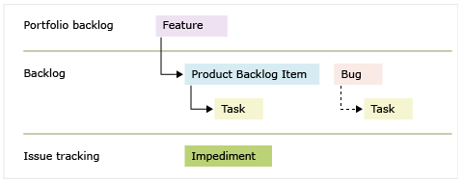
Work Items
Unit of work within TFS
Work Item Type defines “schema” of work
Can be customized, e.g, add new fields, define states

Slide 11
Work Items - Scrum
Demo:
Create work item
Backlog
Kanban

Slide 12
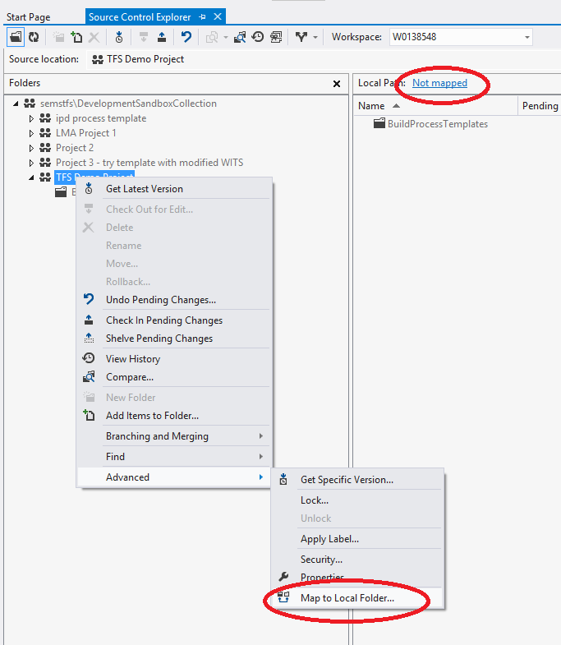
Workspaces
Map the source control folder to a local folder
Recommend mapping the top level source control folder to a short local path
$/ProjectName ➔ c:\projects\ProjectName

Slide 13
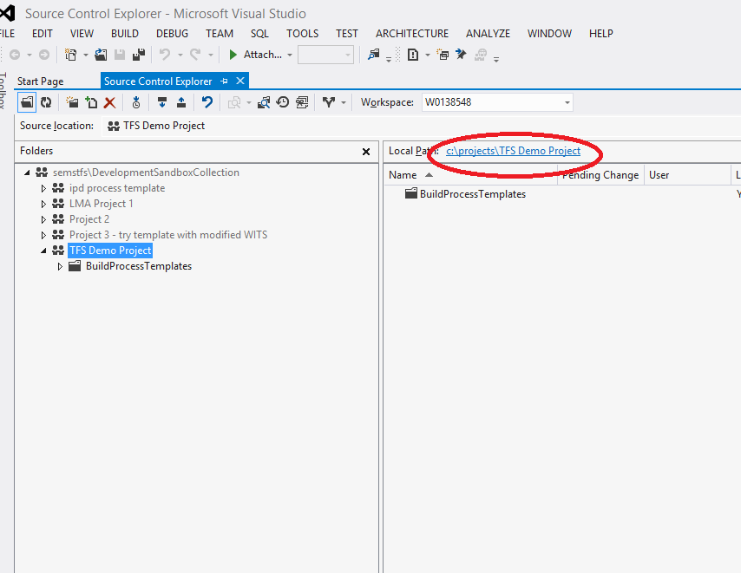
Workspaces
Map the source control folder to a local folder
Recommend mapping the top level source control folder to a short local path
$/ProjectName ➔ c:\projects\ProjectName

Slide 14
Workspaces
You can map individual folders to local folders if needed
This approach is powerful for configuration, but can be confusing for long term support
Can assign security permissions per folder – leads to confusion unless tightly managed

Slide 15
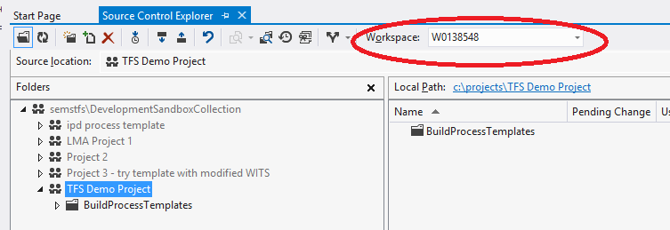
Workspaces
You can have multiple workspaces - default is your computer name
If using multiple computers, you will have multiple Workspaces – but each is computer specific. I.e., not re-usable across computers

Slide 16
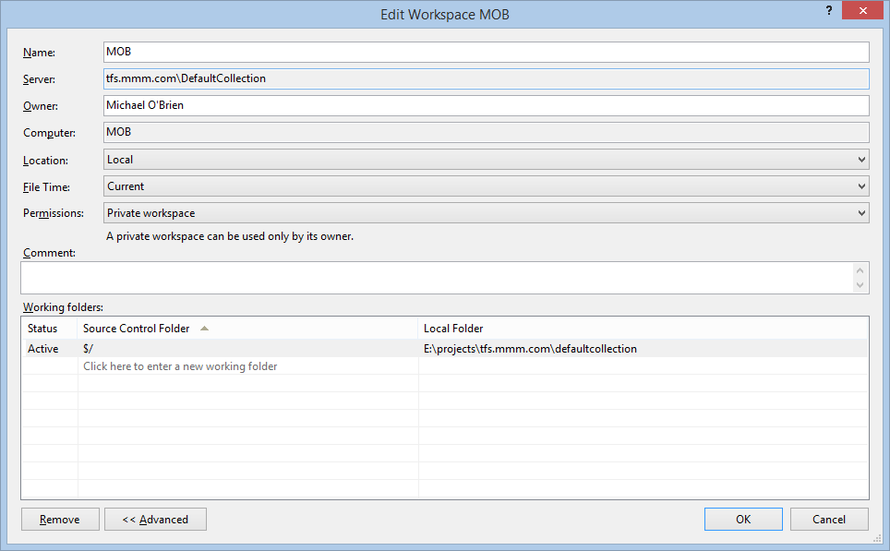
Workspaces – Advanced Settings
Location:
Local
Best for offline use
Does not set +R bit
Files are scanned for changes
Server
File state managed on server
Connection to server necessary
Permissions:
Public workspaces allow multiple users on the same machine

Slide 17
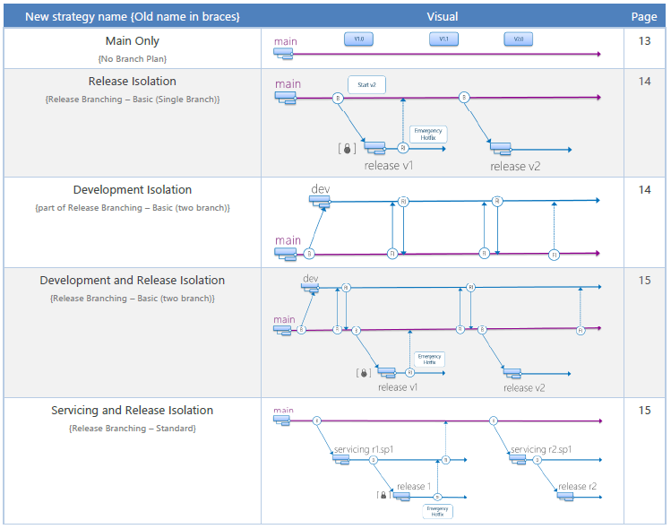
Source Control Structure
Excellent guidance from the ALM Rangers on Branching
http://vsarbranchingguide.codeplex.com/downloads/get/801996

Slide 18
Check in & Check out
How do I get my code into TFS?
Easiest Method
create and/or copy code into working path
“add to source control”
Check in
Note: each Check-in is call a ‘Changeset’ within TFS – and assigned an Id
If you have Power Tools installed – add from Windows Explorer

Slide 19
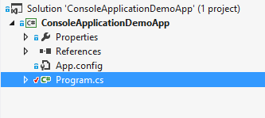
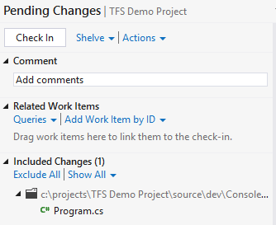
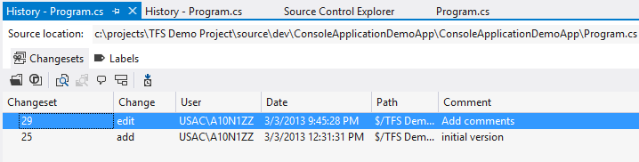
Check in & Check out
How do I get my Team’s code?
Easiest Method
Get Latest on top level folder, or on Solution
Demo: show Check in, Check out, Get Latest, Show History

Slide 20
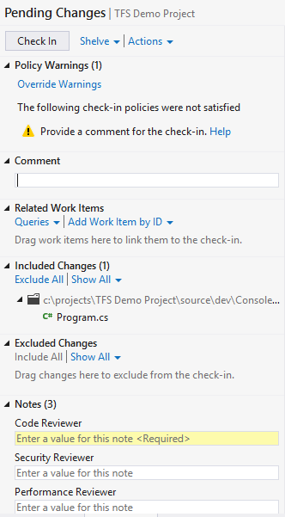
Check in & Check out
Check-in Policies - Allows the team to set norms and enforce, such as:
Check-in comments
Check-in Notes – similar – require notes at Check-in time
Demo: show Check in, Check out, Get Latest, Show History

Slide 21
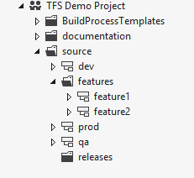
Branching / Merging
Can get complicated – keep it as simple as possible
Increased team size or <1 teams = more complicated
Merge as often as possible – keeps conflicts to minimum

Slide 22
Branching / Merging
Demo – Branching / Merging

Slide 23
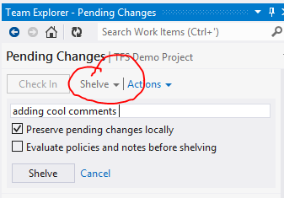
Shelvesets
Shelvesets are useful when you want to stop work for:
Interruption: You have pending changes that are not ready for check in, but you need to work on a different task.
Collaboration: You have pending changes that are not ready for check in but you need to share them with another team member.
Code Review: You want another team member to perform a code review of your pending changes.
Private Build: Before you check in your changes, you can use your automated build system to build and test your code.
Backup: You have work in progress that you cannot finish now so you want a backup copy that is stored on your server and available to other team members who might need to access it.
Handoff: You have work in progress that you want to hand off to another team member.
Suspend Your Work and Manage Your Shelvesets
http://msdn.microsoft.com/en-us/library/ms181403.aspx

Slide 24
Automated Builds
Perform a build on ‘trigger’ operations, such as:
Code Check-in (Continuous Integration)
Fixed time (nightly build)
Requested (manual build)
Automated build can also run Unit Tests to ensure new code is passing automated tests
Tip: When performing an automated build, use the Workspace to only retrieve the minimum source code

Slide 25
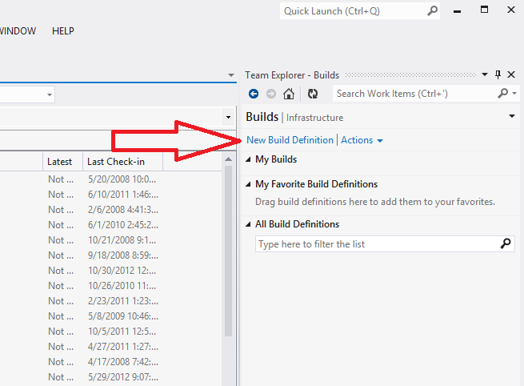
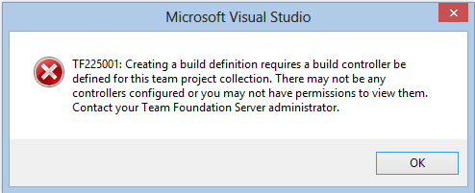
Automated Builds
Demo – define a new build
Need a build controller & build agents for the Project Collection

Slide 26
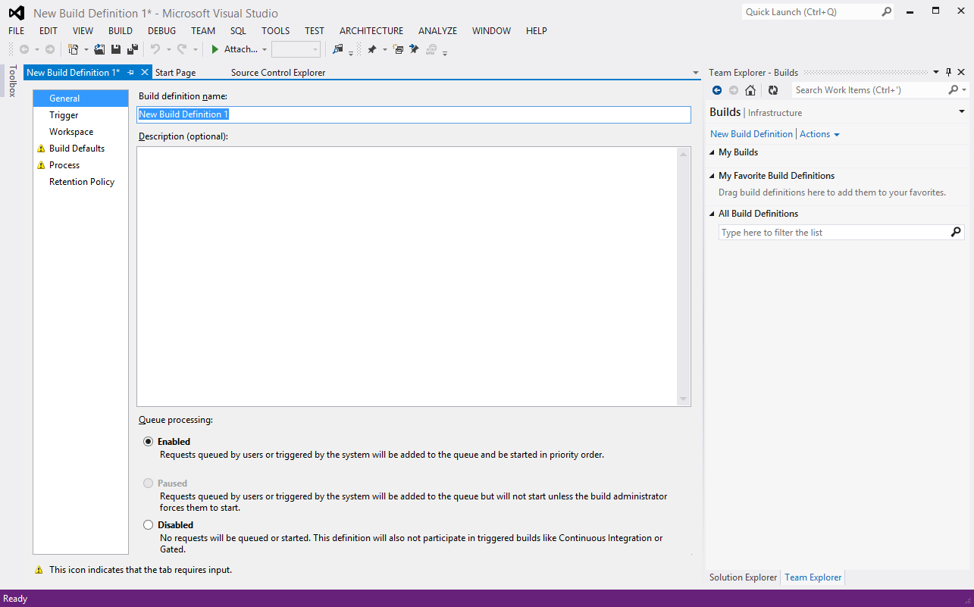
Automated Builds

Slide 27
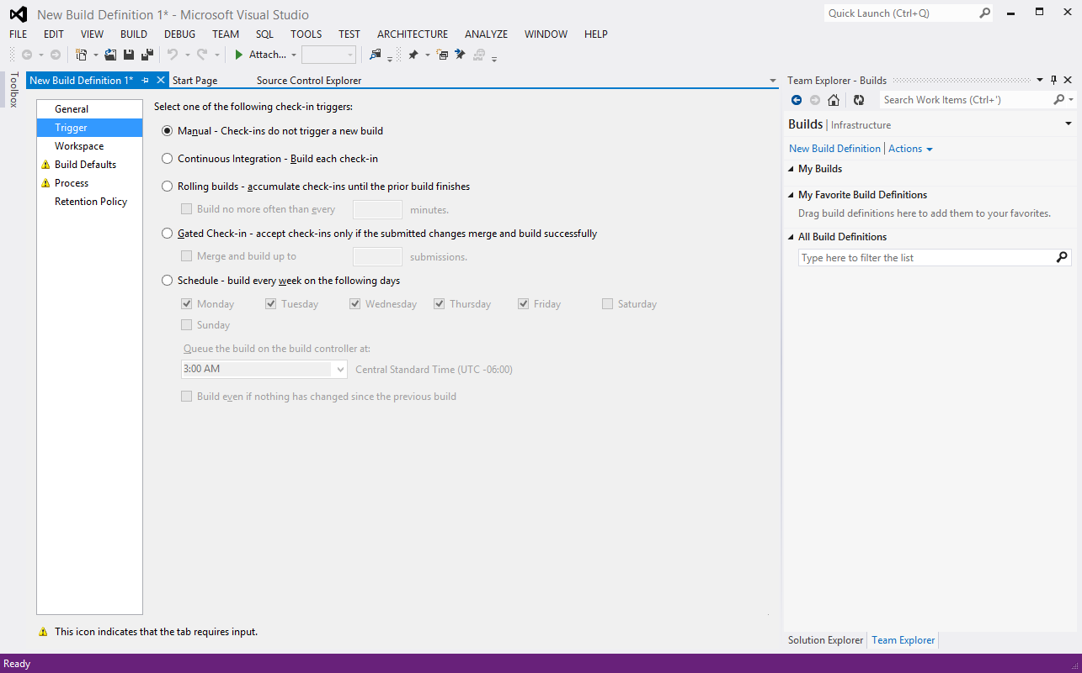
Automated Builds

Slide 28
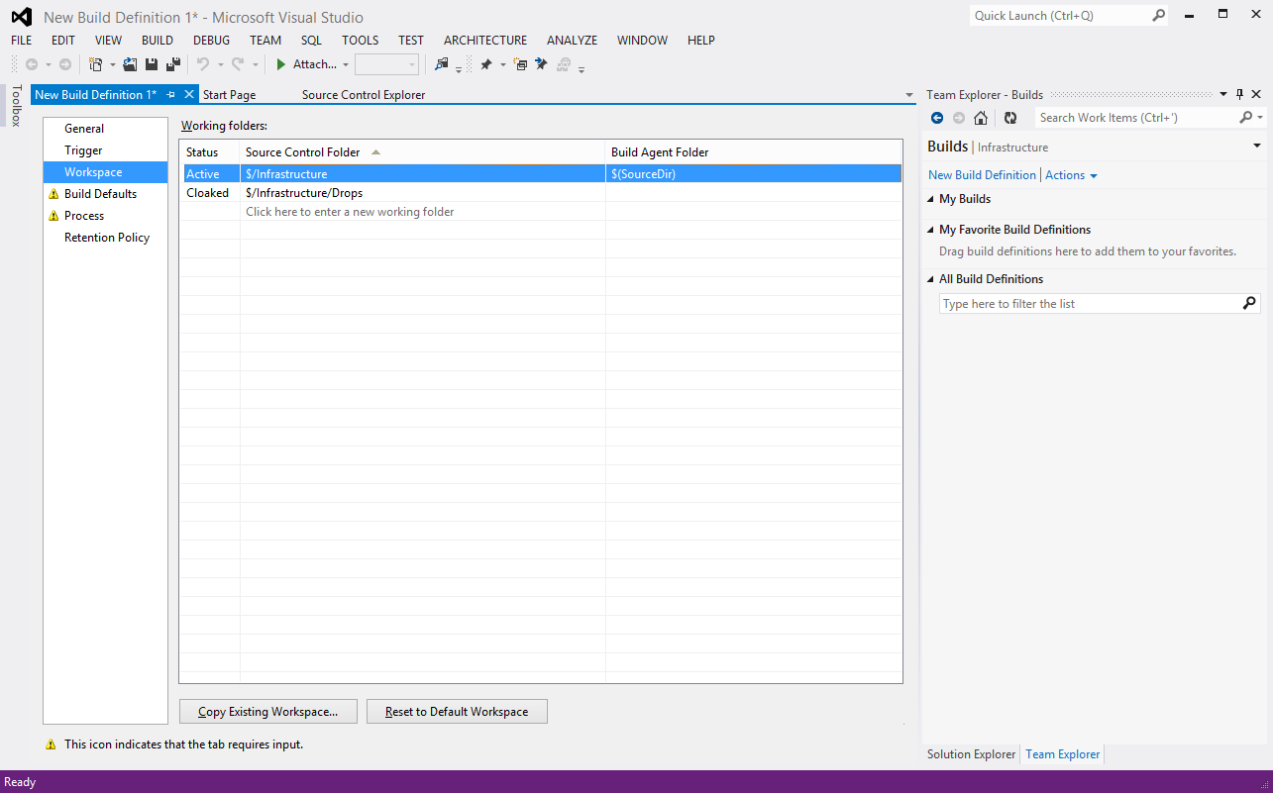
Automated Builds

Slide 29
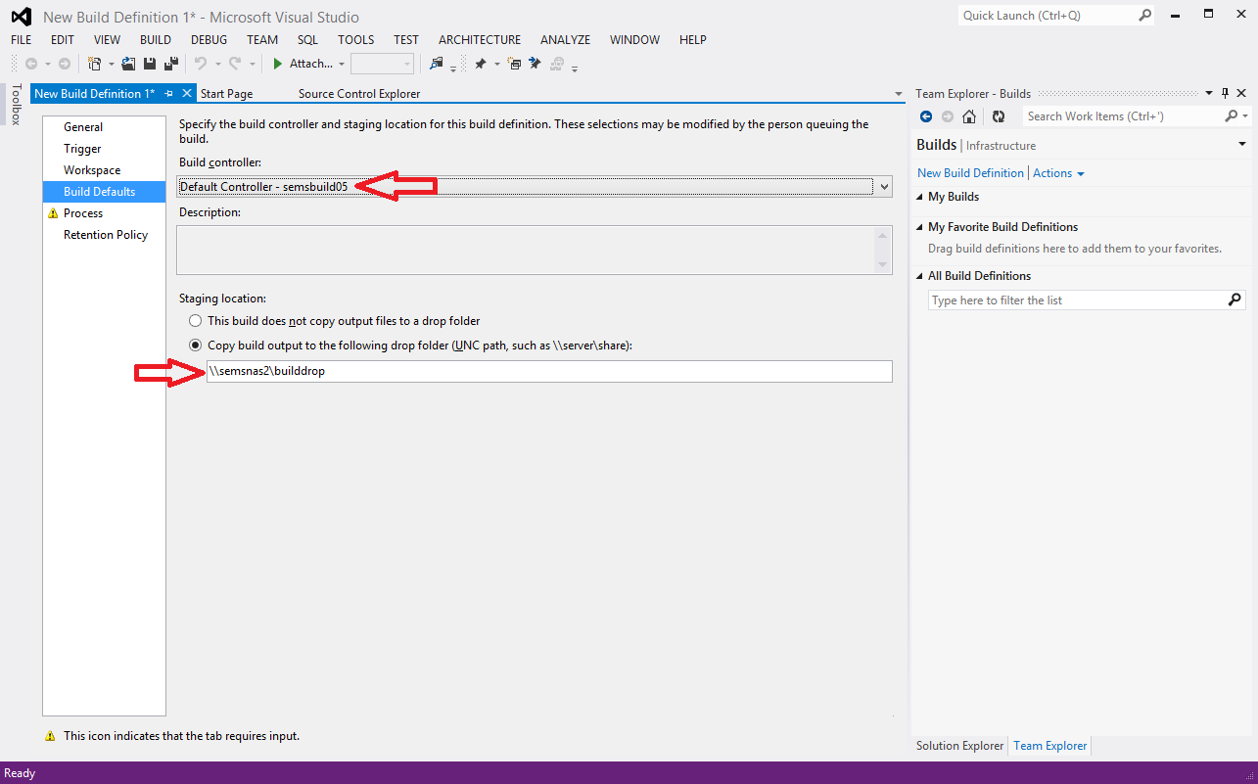
Automated Builds

Slide 30
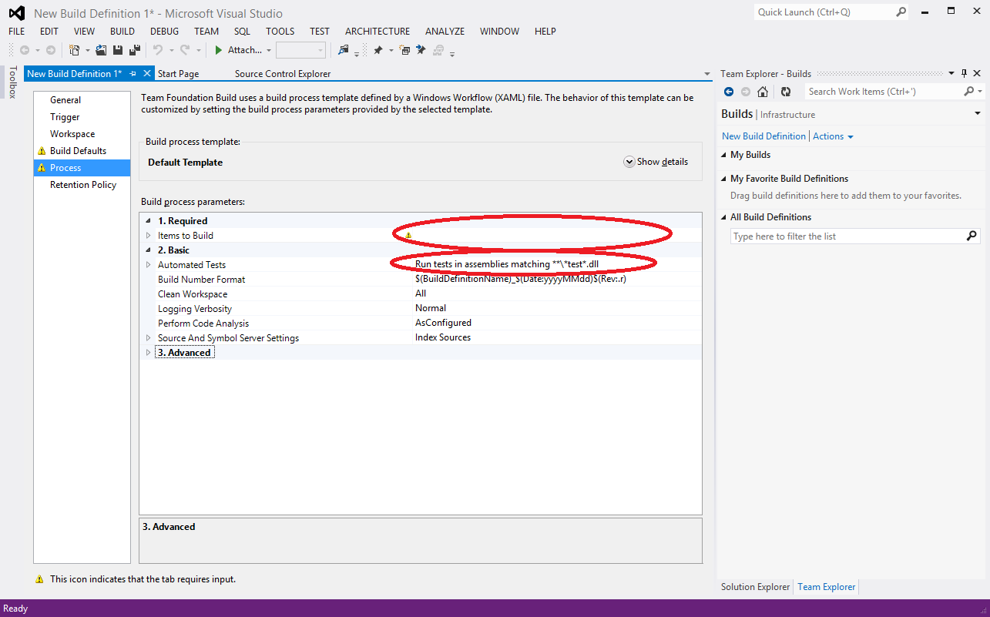
Automated Builds

Slide 31
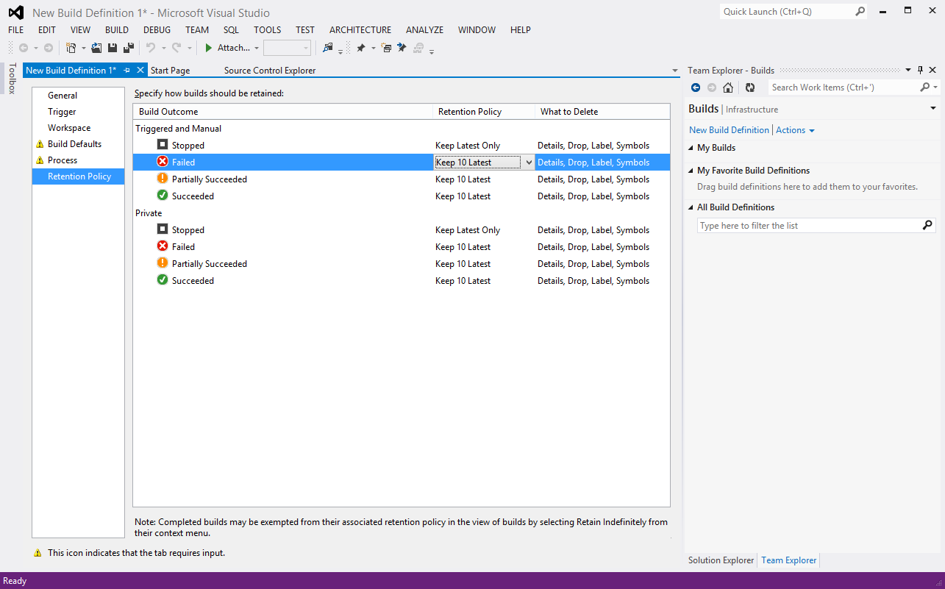
Automated Builds

Slide 32
Thank you!

Slide 33
Resources
Enterprise Team Foundation Server: http://tfs.mmm.com
Use Version Control – TFVC & Git: http://msdn.microsoft.com/en-us/library/ms181368.aspx
TFS Power Tools for 2013: https://visualstudiogallery.msdn.microsoft.com/f017b10c-02b4-4d6d-9845-58a06545627f
The latest version of this file can be found at http://tfs.mmm.com/
Michael E. O’Brien meobrien@mmm.com (651) 733-4652

